Slide 1


Presentation On Digital Document

Slide 2


Digital Document
A digital document is any electronic media content (other than computer programs or system files) that are intended to be used in either an electronic form or as printed output.

Slide 3
Types Of Digital Documents
Active OR Compound Documents (OLE)
Distributed hypertext (HTML)
Structured documents (SGML)
Imaging (TIFF)

Slide 4
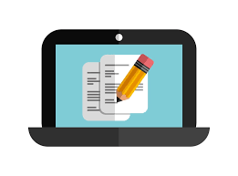

Advantages vs Disadvantages of Digital Document
ADVANTAGES
Speed of creation and communication
Multimediality
Easy management
DISADVANTAGES
New signature authentication methods
Changes in legislation new techniques
for transmission and archiving

Slide 5
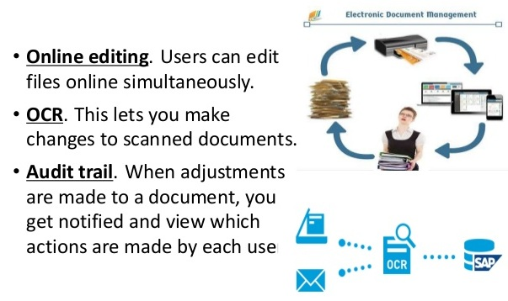
Tools Of Digital Document

Slide 6
